Slide 1
Baby Monitoring System
Group G

Slide 2
Product User Overview
Parents need to keep an eye on their baby at all times
Make sure their baby’s room temperature is no too cold or hot
Make sure the baby is not left crying in another room where they can’t hear him/her
See what s/he is doing (not swallowing LEGO pieces!)

Slide 3
How it’s Used
Parents monitoring their babies when around Loud appliances ->Can’t hear the baby
Working at home -> Can’t have an eye on the baby
Parents are out when baby sleeping -> room gets too cold or if the baby wakes up(phone app version)

Slide 4
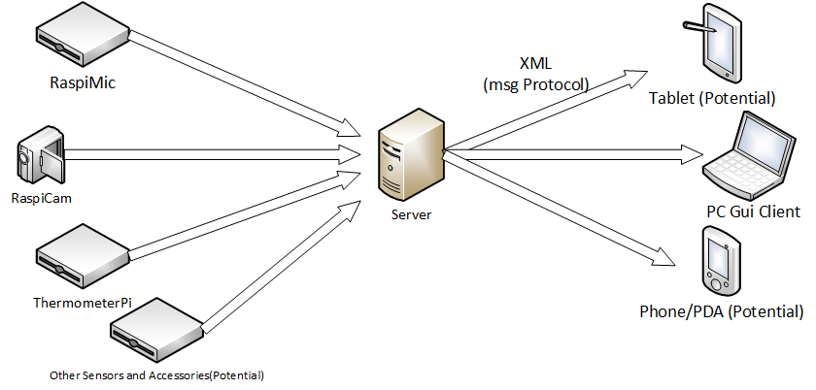
System Architecture

Slide 5
Server
Written and executed in Jython for parallelism
Accepts data from input clients(Thermometer pi/Mic pi)
Packages the data into an xml string
Send the data to the output clients (Java gui)

Slide 6
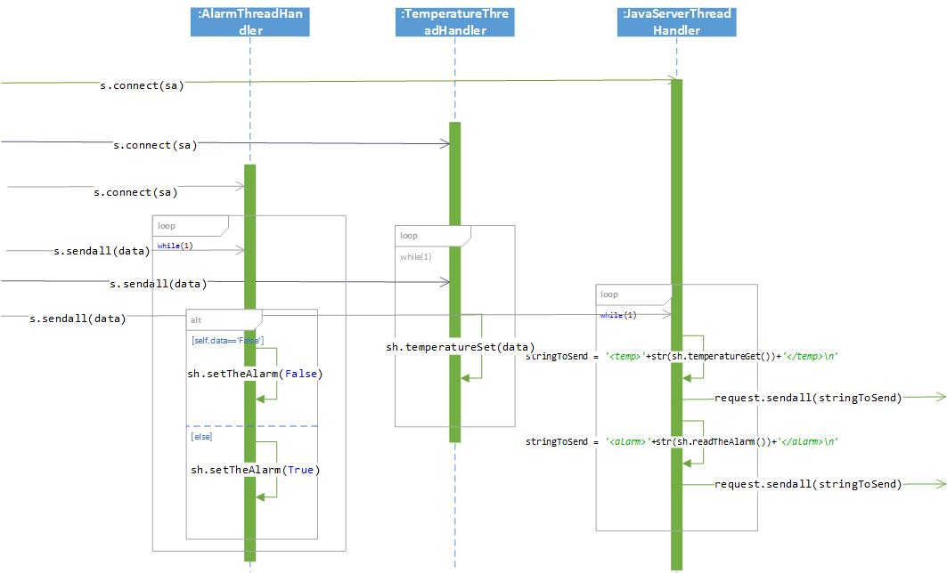
Sequence Diagram

Slide 7
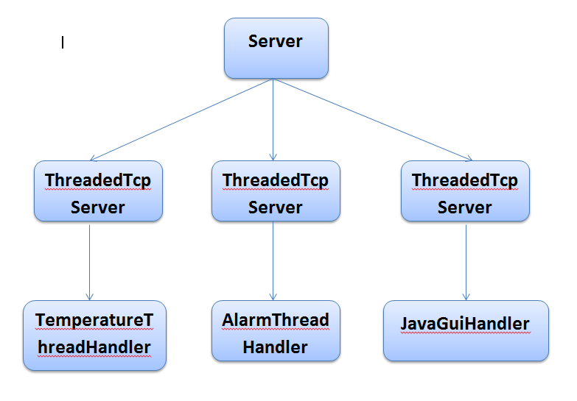
Server Class Like Diagram

Slide 8
Server Testing
Using PyUnit testing for integration testing
Functionality testing with dummy clients

Slide 9
ThermometerPi
Function:
Monitor the temperature in the surrounding environment.
Specification:
1- Digital thermometer provides 9-bit to 12-bit Celsius.
2- Needs 1-Wire bus that by definition requires only
one data line (and ground)
3- Its operating temperature range of -55°C to +125°C
4- is accurate to ±0.5°C over the range of -10°C to +85°C.
Required Components:
1- Breadboard.
2- Jumper cables to connect it to the GPIO header.
3- DS18B20 Temperature Sensor.
4- Green and Red LEDs

Slide 10
ThermometerPi
Setup:
1- Pin 1 to be connected to P1-06 (Ground)
2- Pin 2 to be connected to P1-07 (GPIO4)
3- Pin 3 to be connected to P1-01 (3.3V)
4- A 4.7K resistor between Pin 2 and Pin 3.
5- Pin 24,25 with two 220 resistors, to be
Connected to the Green and the Red LEDs
Settings.xml
Info
By using (xmlpar.py)
Allinone.py
To control the LEDs and monitor the readings
Testcases.py
To test the functionalities for the soft/hardware
Uses
Uses
Important:
Preferred Temperature Ranges Must be entered in the XML File (settings).
The default Range is MaxTemp is 24 C and the MinTemp is 19 C.

Slide 11
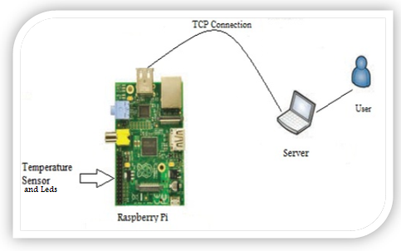
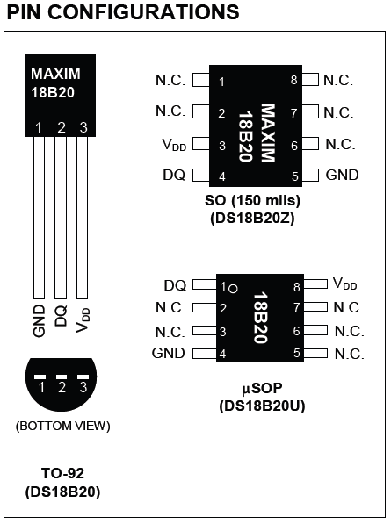
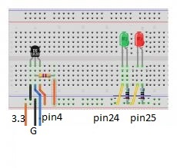
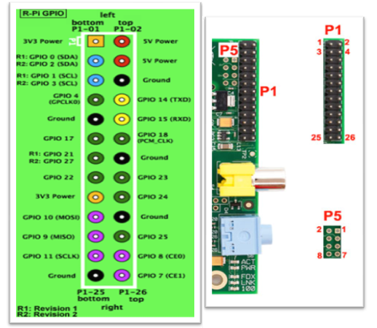
ThermometerPi
General Overview
DS18B20 PIN configurations
Connecting Temperature sensor and LEDs
The standard GPIO map for the Raspberry Pi and its GPIO Headers

Slide 12
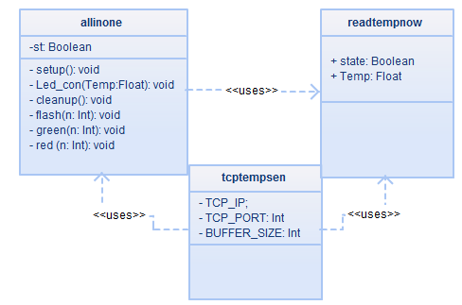
ThermometerPi
Test results
Function Name | Test | Information/ Action | Expected result
Readtempnow | Sensor | Read Temp | Reasonable reading
geen | Green Led | (on,off) | Green Led on
red | Red Led | (on,off) | Red Led on
Led_con | Led+Temp | T=Max | Flashing (red)
Led_con | Led+Temp | T=NR | Green led is on
setup | Led+Temp | Nothing | Flashing green
cleanup | Led+Temp | Nothing | Flashing (green and red)
 | HTCase1 | Use an ice cube | Readings are decreasing
 | HTCase2 | Use a hot object | Readings are increasing
Figure3: Simplified Class Diagram
void Setup(void);
wiringpi.pinMode(25,1) #red light wiringpi.pinMode(24,1) #green light
void Led_con(int Temp);
wiringpi.digitalWrite(24,1) #green is on
*Temp value is between predefined limits.
Initialize GPIO
(sensor and LEDs)
Normal mode
1- Read Temp
2- Detects and reports the status of the system
Reset GPIO
(sensor and LEDs)
Dangerous mode
void cleanup(void);
wiringpi.digitalWrite(25,0) #red is off wiringpi.digitalWrite(24,0) #green is off
void Led_con(int Temp);
wiringpi.digitalWrite(25,0) #red is on wiringpi.digitalWrite(25,1) #red is off
*Temp value is Out of normal Range.
Figure1.1: General view of the Temperature sensor’s functionality

Slide 13
RaspiMic
Function:
Transmits data on the sound from the baby’s room to the server being monitored by the parent.
Schematic Diagram:
Figure 1: Microphone to raspberry pi interface
Requirements:
Snowball iCE Microphone
Raspberry pi
Microphone Specifications:
Sample/Word =44.1 kHz/16 bit
Frequency response=100Hz – 16 kHz
Compatible with PC or Macintosh
Raspi
USB
Microphone
Sound coming into microphone

Slide 14
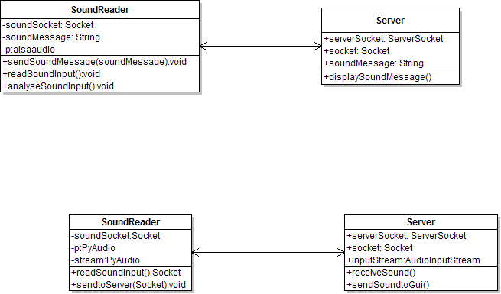
RaspiMic
Incremental Progress:
The implementation of the RaspiMic will progress in an incremental fashion. The sound read from the area is read in a periodic fashion. The periodic time interval for reading the sound is set through XML.
Reading the sound and analyzing the waves to specify if the sound is alarming.
Reading the sound and transferring it through UDP/TCP packets to the server.
TCP
TCP
TCP

Slide 15
Functionality of RaspiMic
First step
Second step
Void setup()
Opens input device and
Sets its attributes for
reading data
Void readData(device)
Read data and verify the
max of the samples
1, Read sound from
environment
2, Determine if sound is
dangerous or not
Dangerous mode
Normal mode
Void analyseData(vol)
*vol <10000
Send “0” to server
Void analyseData(vol)
*vol >=10000
Send “1” to server
Third step

Slide 16
Test Results and Implementation of RaspiMic
Function Name | Argument | Return type | Passed Information | Expected result | Actual result
Setup() | Nothing | variable for device just set up | Nothing | Nothing | Nothing
readData | variable for device just set up | Volume of maximum sample | Nothing | Nothing | Nothing
analyseData | Volume of maximum sample | Nothing | V=min(10000) | Send “1” to server | Send “1” to server
analyseData | Volume of maximum sample | Nothing | V=max(9999) | Send “0” to server | Send “0” to server

Slide 17
OV5647 Camera Specification
RaspiCAM
Name | Resolution | Frame per Second (fps)
 | Width x Height
5 Mega pixel | 2592 x 1944 | 15
1080p (Full High Definition) | 1920 x 1080 | 30
960p (Quarter High Definition) | 1280 x 960 | 45
720p ( High Defitnition) | 1280 x 720 | 60
VGA (Video Graphic Array) | 640 x 480 | 90
QVGA (Quarter Video Graphic Array | 320 x 240 | 120
Table 1: Raspicam Image Transfer Capability [1] [Raditya Budianto]

Slide 18
Raspicam Specification:
Current draw: [1]
Idle: 117 mA
Active: 268 mA
Input Voltage: 3.3 V [1]
Connect with Raspberry Pi via S5 slot (CSI-2 Camera Serial Interface port , 15-pin flat flexible connector)
BCM 2835 Processor
Features: [3]
Low Power ARM1176JZ-F Applications Processor[
Dual Core VideoCore IV® Multimedia Co-Processor
1080p30 Full HD HP H.264 Video Encode/Decode
Advanced Image Sensor Pipeline (ISP) for up to 20-megapixel cameras operating at up to 220 megapixels per second
Low power, high performance OpenGL-ES® 1.1/2.0 VideoCore GPU. 1 Gigapixel per second fill rate.
High performance display outputs. Simultaneous high resolution LCD and HDMI with HDCP at 1080p60

Slide 19
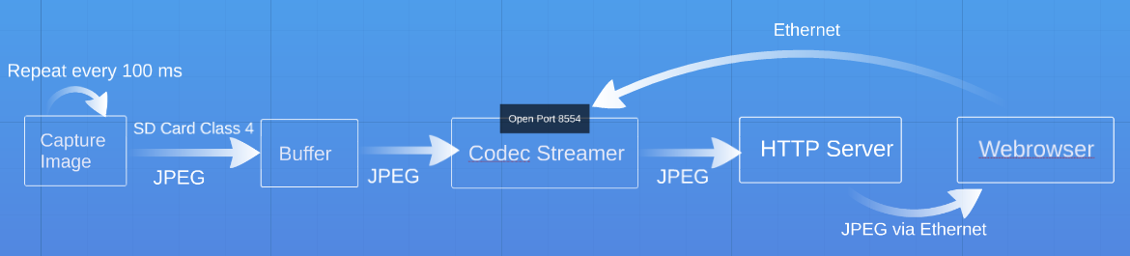
Top Level System Overview
Figure 1: MJPEG Video Stream System Architecture [Raditya Budianto]

Slide 20
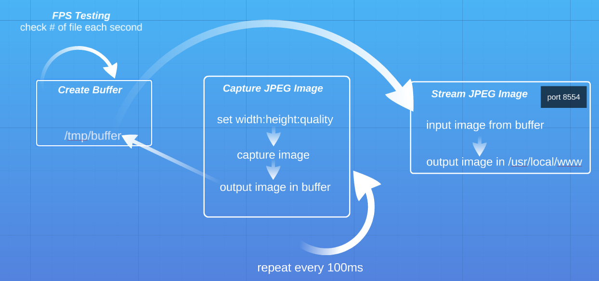
Video Stream Software Flow
Figure 2: Video Stream Software Flow [Raditya Budianto]

Slide 21
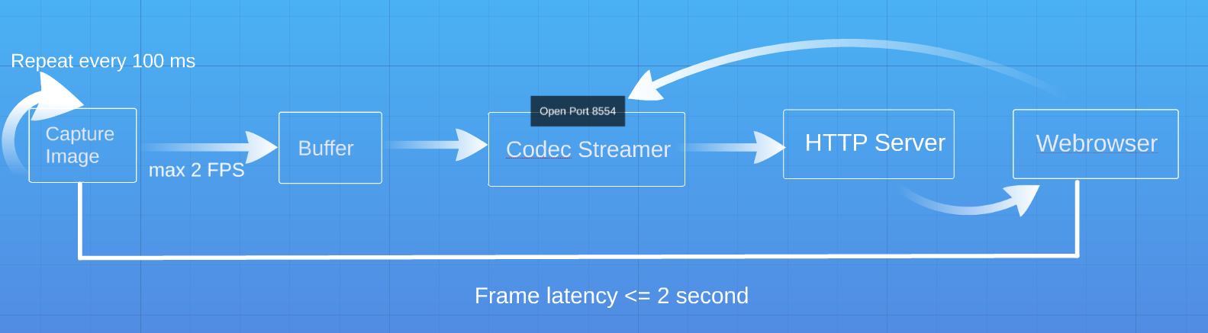
Video Stream Result Performance
Figure 3: Performance Result of Video Stream System. [Raditya Budianto]

Slide 22
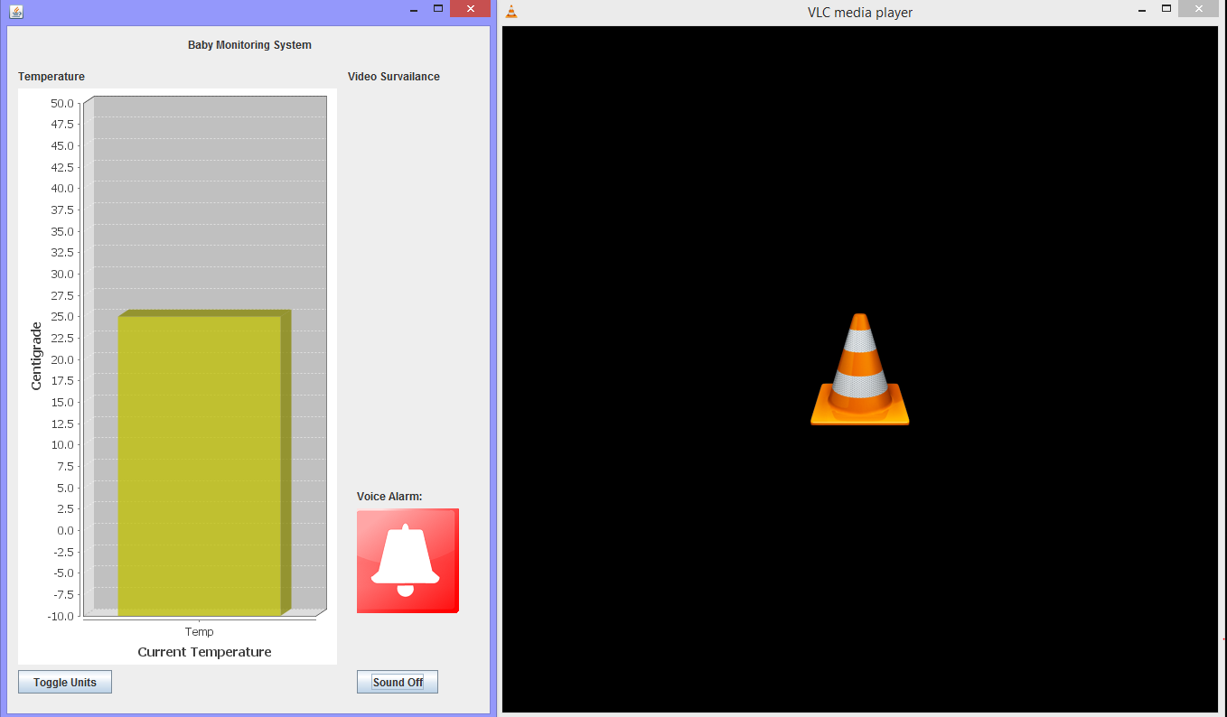

GUI Client

Slide 23
Functionalities:
Monitoring Station for temperature, Video and Sound
Alarm on higher than threshold frequency noise levels
Alarm sound on/off button
Selectable Imperial/Metric units for temperature display
Design:
MVC
Connection thread modifies Model
Changes to model (by main thread or controller event handling) reflected to gui by simplified one to one observer pattern

Slide 24
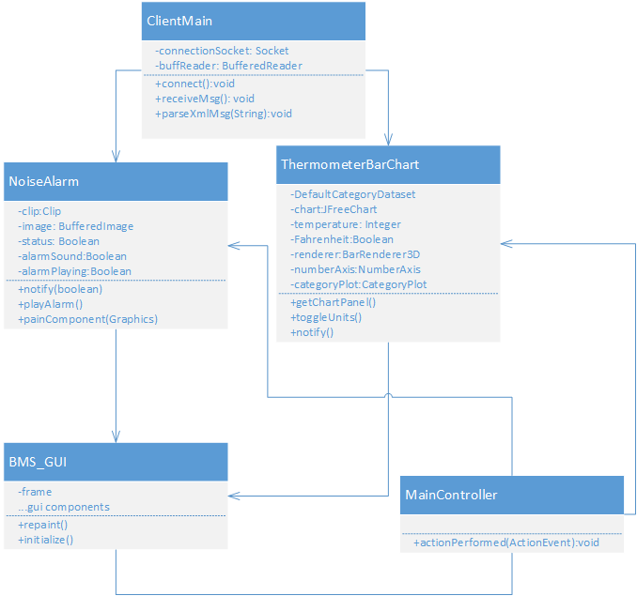
Class Diagram

Slide 25
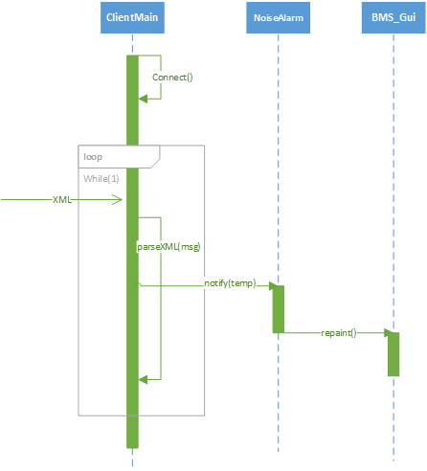
Data reading Scenario:

Slide 26
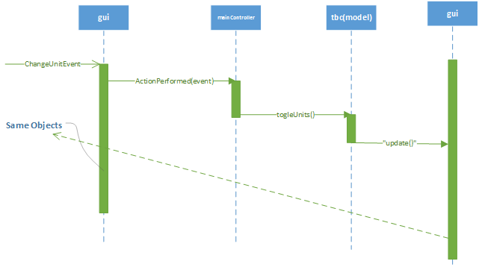
Event Handling Scenario:

Slide 27
References for RaspiCam
[1]https://www.sparkfun.com/products/11868. Accessed 11 October 2013.
[2]http://www.designspark.com/blog/time-lapse-photography-with-the-raspberry-pi-camera. Accessed 11 October 2013.
[3] http://www.broadcom.com/products/BCM2835. Accessed 29 November 2013.

